Slide 1
MISSION:
Promise
Mission Promise is very flexible. It can be achieved by completing 6 or more missions that you may pick and choose. Within each of these 8 missions there are a number of ideas to help you adapt it to your individual units needs. You are welcome to complete all of these, add your own ideas (which I would love to hear about) or complete just a selection.

Slide 2
Mission: Promise planning
Mission Number One: Do Your B.E.S.T. Get Your Guides to give one or more of the following activities their B.E.S.T. shot!
You B.E.S.T. Believe… | Get cheap photo frames and remove the glass (could be saved for some glass painting or etching) Buy a selection of papers Buy scrabble tiles Get the Guides to deco-patch the inside of the frame and stick the scrabble tiles on to spell out BELIEVE Get them to hang it somewhere they can see it every day so they can be reminded that Seeing it is Believing it which is Achieving it.
Ribbon Bead Keyring/Badge | Get some ribbon or cord and multi-coloured beads – thread on the beads onto a doubled over piece of the ribbon/cord and tie a knot in the end. Attach this to a keyring or safety pin and wear to Guides to remind them that: Red: Brave Orange: Trusted Yellow: Helpful Green: Eco Friendly Purple: Friend Blue: Polite
Signing the Promise | Ask the Guides to use sign language to communicate the promise.
Rapping the Promise | Ask the girls to turn the Promise into a Rap or a Song and get them to perform it and maybe even video it.
Promise Jar | Get each Guide to bring a jar. Paint the jars and decorate them. Get each Guide to fill their jar with promises . Get them to pull out their promises daily, weekly or monthly and to do their best to fulfil them.

Slide 3
Mission: Promise planning
Mission Number Two: Zen-ify Make a candle pot our of salt dough and paint/decorate it Light candles and put them in the pots and sit in a circle to sing songs, read poems and talk about beliefs Have a yoga or meditation session Paint a Rock with the word ‘BELIEVE’ and share what you believe and have faith in
Mission Number Three: Believe it or Not Word Game: Reading Real and Fake words and their definitions and get them to guess which are real and which are fake by running between 2 sides of the hall (real v fake). The ones who guess wrong are out and keep going until you have a winner The promise hasn’t always been the same – talk about its evolution: love my god and serve country Ask the girls if they can do something weird or extraordinary.
Mission Number Four: God Save Our Queen Sing the national anthem Use stamps to create an arty print of the queen Hold a Queen of Hearts Tea Party with Home baked Tarts! Discuss with the Guides what they would do if they were queen for the day
Mission Number Five: Secretly Serving Others For the Next Seven Days you are required to perform random good deeds in order to help other people.
Mission Number Six: M.U.M. M.U.M. Night: Invite Mums, Guardians, God Mums, Sisters or Mother Figures to join you for a meeting to celebrate being a ‘unique me’. Get them to make origami flower bookmarks together and write a compliment about each other on the flowers petals. Get them to give each other a mini-pamper session and show how to hand massage. Get them talking by giving them a template for a fortune teller with leading questions for discussion. Get each guide to ‘Make a Date’ with their M.U.M. to do something together and snap a selfie of this, and tell the unit all about it

Slide 4
Mission: Promise planning
Mission Number Seven: Diffuse the Bomb Time is running out. In order to diffuse the Bomb threatening GGHQ we need a password. In order to find the password the guides must pop a load of balloons – some of which include pieces of bunting which have the promise written on. They must pop all of the balloons to find these as they are the code to stop the bomb. Once all the pieces of the code have been found the Guides must race against time and each other to thread the bunting onto string in the correct order to spell out the promise. Trefoil Beetle Drive with sweets Decode the promise – code spinner
Mission Number Eight: Fingers and Thumbs Heart hands with what they love about guides on one and what they love about themselves on the other that can then be folded into a salute
Mission Number Nine: Save the Earth it’s the only planet with chocolate Turn off lights, taps and hold an eco night Have a meeting in the dark – maybe your zen night with candles or playing games in the dark Make a bird feeder and hang it up – photograph any birds feeding on it Use the bottom of a bottle to be a plant pot or decorate a plastic plant pot and plant some seeds – these will grow as your grow in guiding and they will blossom as you blossom – take photos to document this and share using a special unit hashtag Make earth cupcakes – blue and green tie dye cake mix and top with white chocolate frosting serving as snow and talk about how it is getting rarer with global warming Use the fruits of the earth to make kebabs and dip them in chocolate
Mission Number Ten: The G-Team Celebrate being part of the guiding family and have your promise ceremony and welcome all new members into the folds of your unit. Mission: Save Sam (Challenge in Teams) Leave your Mission Promise Top Secret Book Open ready for each of the other Guides to write something nice about you in. Play some team games.

Slide 5
Mission Number Three: Believe it or not
True WORDS
AEGIS: Sponsorship and protection
AUREOLA: Halo
COLLYWOBBLES: Nervousness
CORRIGENDUM: Error to be corrected
COTONEASTER: Garden Shrub with Red Berries
DEUTERIUM: Isotope of Hydrogen twice as heavy as a normal atom.
DOXOLOGY: Short Hymn of Praise to God
EOLITHIC: Early part of Stone age
EXTEMPORIZE: Speak, perform or compose without preparation
FLAGEOLET: Small instrument like a recorder
FOP: Man concerned with fashion
FRIZZLE: Cook or heat until crisp and shrivelled
GIBBOUS: More than half but less than fully illuminated
HINTERLAND: Land lying near coast
INSOUCIANT: Carefree and Unconcerned
LUDERICK: Australian Fish
MNEMONIC: Rhyme or something to help memory
OBSTREPEROUS: Unruly and Noisy
PAUCITY: Scarcity
PHLOX: Flowering Garden Plant
SAGACIOUS: Wise
SHINTO: Japanese Religion
STROBOSCOPE: Instrument producing a bright flashing light
TRANSMOGIFY: Change Completely
VERMILION: Orange/Red
YABBY: Small freshwater crayfish

Slide 6
Mission Number Three: Believe it or not
False WORDS
ALIMENTRIMENT: Nutrition
ASSEGUAL: Analysis of Substance
BAULKHEAD: Aeroplane partition
ADDICTIONARY: A steadily growing list of made-up words invented by people who feel compelled to take an active part in the development of language.
CONFRAZZLED: The state of being simultaneously confused and at the end of one's wits.
FLUNGE: To Unblock a pipe
TITHESIS: Crux of problem
SCRITTLE: Scratching Gently
RUTHFULL: Terrible and Unkind
BELLIGNORANT: Difficult and Ignorant
ELOQUACIOUS: Desirable and beautiful and elegant
PUFFALOPE: A breed of antelope
OPSABLEPSIA: Inability to look someone in the eye
OBLIVIA: Not noticing and distracted
GIRAFFITI: High placed vandalism
DECAFALON: Getting through a difficult day
ONISM: Awareness that you understand little about the world
AVENOIR: Memory flowing backwards

Slide 7
I
promise
that
I will
do my
best
To be
true to
myself
& develop my
beliefs
To serve the
Queen
& my community
To help other people
& to keep the Guide
law
Diffuse the Bomb
Balloon Popping Game

Slide 8
MISSION:
Promise
Guide Edition Created by 5th Worksop Methodist brownies

Slide 9
Mission: Promise
Mission Number One:
Do Your B.E.S.T.
Mission Number Two:
Zen-ify
Mission Number Three:
Believe it or Not
Mission Number Four:
God Save Our Queen
Mission Number Five:
Secretly Serving Others
Mission Number Six:
M.U.M.
Mission Number Seven:
Diffuse the Bomb
Mission Number Eight:
Fingers & Thumbs
Mission Number Nine:
Save the Earth it’s the only
Planet with Chocolate
Mission Number Ten:
The G-Team

Slide 10
The Guide Promise
I promise that I will do my best:
To be true to myself and develop my beliefs,
To serve the Queen and my community,
To help other people
and
To keep the Guide Law.
The Guide Law
A Guide is honest, reliable and can be trusted.
A Guide is helpful and uses her time and abilities wisely.
A Guide faces challenge and learns from her experiences.
A Guide is a good friend and a sister to all Guides.
A Guide is polite and considerate.
A Guide respects all living things and takes care of the world around her.

Slide 11
Secret Agent:
.…………………………
Your mission, if you choose to accept it, is to complete a series of Challenges in order to help you understand ‘What it is to be a Guide’, the Guide PROMISE and the Guide LAWS!

Slide 12
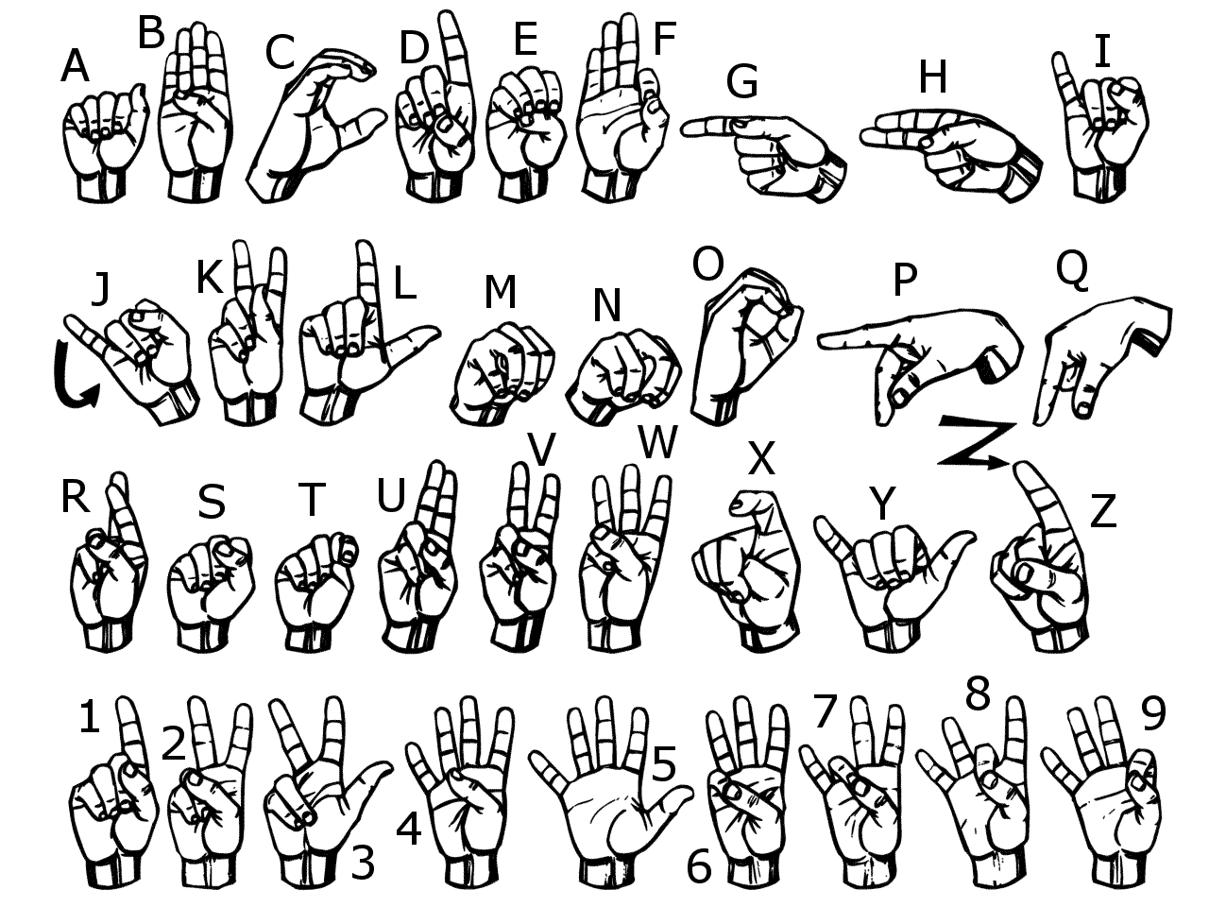
Mission Number One:
Do Your Best
Give Signing the Promise your best shot!

Slide 13
Mission Number one:
Do your b.e.s.t.
Secret Agent, looking your best can help you be your best. To help you be your best we want to see you wearing your BEST outfit and give a new hairstyle your BEST shot for Guides on : / /201
Secret Agent, we need you to undertake a personal mission. You must make a promise to do something. Something new or exciting or something you don’t like and do your best to fulfil the promise.
What did you promise to do?
.…………………………
Your Mission is to plan a B.E.S.T. Night at Guides involving all of your Best Guiding Activities, Songs and Games. List your B.E.S.T. of each in your top secret files to help your G-Team plan.
B.E.S.T. Game
B.E.S.T. Song
B.E.S.T. Activity

Slide 14
Mission Number two:
Zen-ify
Agent, this is your chance to take a break and relax, forget about the pressures of Missions and develop your beliefs and spirituality.
What do you believe in?
.…………………………
Design a Zen-ifying Candle Holder:

Slide 15
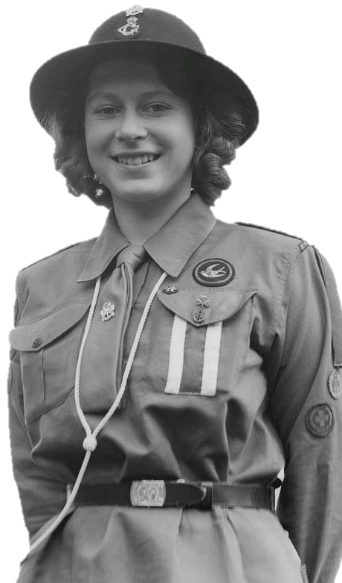
Mission Number Three:
Believe it or not
SIGN HERE ONCE THE MISSION IS COMPLETE: | …………………
Mission Number four:
God save our queen
God save our gracious Queen
Long live our noble Queen
God save the Queen
Send her victorious
Happy and glorious
Long to reign over us
God save the Queen

Slide 16
Mission Number five:
To Secretly Serve Others
For the Next Seven Days you are required to perform random good deeds in order to help other people.
First, you must pick your target.
This will be the person you will help.
Then, you must decide on a kind deed or act to perform for them.
DO NOT BLOW YOUR COVER!
Examples of kind deeds or acts:
Do a chore & your homework without being asked
Write a note to someone telling them how much you appreciate them
Smile at 3 random people
Bake something for someone or have a go at cooking tea for your family
Pick up rubbish on your way to school
Set the table for dinner
Read to a little Brother/Sister
Write a nice comment about someone on social media
Good Luck Agent on Your Mission to Secretly Serve Others!

Slide 17
Mission Number five:
To Secretly Serve Others
 | Your Target | Your Good Deed
Wednesday
Thursday
Friday
Saturday
Sunday
Monday
Tuesday

Slide 18
Mission Number Six: M.U.M.
Mission.Unique.Me
I’m Unique Because I am…
1.
2.
3.
My M.U.M. Moment!
Draw a Picture or
Print a Photograph

Slide 19
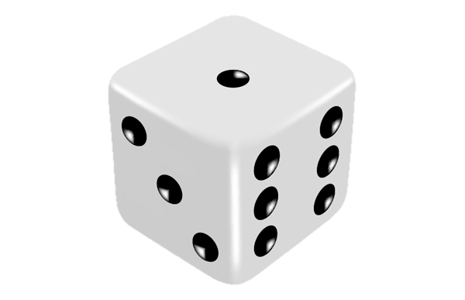
Mission Number Seven:
Diffuse the bomb
Secret Agent, you must race against the clock and other agents to roll each number on the dice and create a Trefoil out of sweets!
1. | Outline Strawberry Lace
2. | Leaf 1 Chocolate Button
3. | Leaf 2 Chocolate Button
4. | Leaf 3 Chocolate Button
5. | Flame Jelly Bean or Jelly Snake
6. | Star Magic Star

Slide 20
Mission Number Eight:
Fingers & Thumbs
The Guide Salute
Instructions:
Fold an A4 piece of paper in half. Draw around your hand with the forefinger and thumb next to fold of paper. Cut out the hand leaving the fold in place where fingers reach fold. Open it out and write something you love about Guides on one side and the promise on the other. Then close up the hands and fold down the correct fingers for showing the
Guide salute.

Slide 21
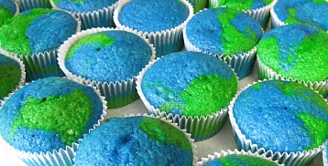
Mission Number Nine:
Save the world it’s the only planet with chocolate
Earth Cupcakes Ingredients
100g 100g 2 medium 100g | Marg Caster Sugar Eggs S.R. Flour
Method
Heat oven to 190ºC, 375ºF, Gas Mark 5. Have ready 18 paper cases in bun tins. Cream margarine and sugar until light and fluffy. Beat in eggs, one at a time, adding a little flour with each. Gently fold in remaining flour. Split the mixture between 2 bowls, adding blue food colouring to one and green to the other. Half fill the paper cases with a mix of the 2 mixtures and bake for about 15 minutes until firm.
Bird Feeder
Ingredients
Good quality bird seed; raisins; peanuts; grated cheese; suet or lard; yoghurt pots; string; mixing bowl; scissors
Method
Make a hole in the bottom of a yoghurt pot and thread string through to create a loop to tie it up. Cut the lard into small pieces, Add all the other ingredients until the fat holds it together. Fill the yoghurt pot with mixture and then leave in the fridge for it to set.

Slide 22
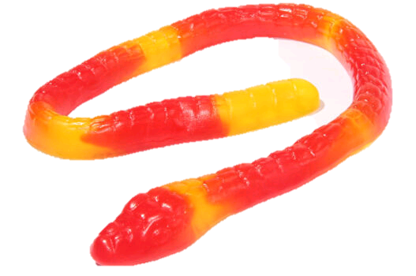
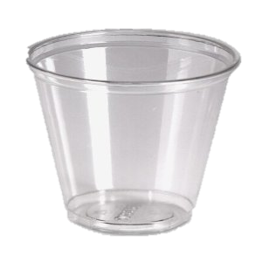
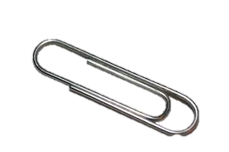
Mission Number ten:
The G-Team saves Sam
Secret Agents, we need you to work together to Save Sam the Snake. After encountering the deadly rapids, Sam’s boat capsized. Sam cannot swim and his life ring is trapped under his boat. He now sits on top of his boat with his oar, contemplating what to do next. You must SAVE SAM by flipping the boat back over, sitting Sam in it and popping on his Life Vest. However, you cannot touch Sam. You may use the paperclips, elastic band and the ‘oar’ provided but you cannot stab him or let him fall into the water and drown.

Slide 23
Mission Number ten:
The G-Team
I am Agent
.………………………
And I am a member of the
.…………………… Guides
The g-team Think I Am

