Slide 1
MISSION:
PRomise
Printing Instructions
Print off Slide 2 on its own – set as 2 pages per sheet
Print off 3-13 as a Booklet on Printer Settings
Print off 14 & 15 as full pages
Print off 16 as 2 pages per sheet
The titles on slide 16 are to be used for sticking on the envelopes holding the Mission’s Required Contents such as ‘jigsaw pieces’ and ‘bunting’ and ‘string’

Slide 2
MISSION:
PRomise
Tales from Twinkle owl: PROMISE MISSION FOR NEW BROWNIES

Slide 3
Mission: Promise
Mission Number One:
To Secretly Serve Others
Mission Number Two:
To Be True To Myself
Mission Number Three:
Fingers & Thumbs:The Brownie Salute
Mission Number Four:
Problem Solving
Mission Number Five:
Brownie Bunting
Mission Number Six:
Muddled Queen

Slide 4
Secret Agent:
.…………………………
Your mission, if you choose to accept it, is to complete a series of Challenges in order to help you understand ‘What it is to be a BROWNIE’ & the BROWNIE PROMISE!

Slide 5
The Brownie Promise
I Promise that I will do My Best:
To be True to Myself
And Develop My Beliefs
To Serve the Queen & My Community
To Help Other People
And to Keep the Brownie Guide Law
Brownie Guide Law
A Brownie Guide Thinks of Others Before Herself & Does a Good Turn Everyday.

Slide 6
Mission Number One:
To Secretly Serve Others
For the Next Seven Days you are required to perform random good deeds in order to help other people.
First, you must pick your target.
This will be the person you will help.
Then, you must decide on a kind deed or act to perform for them.
DO NOT BLOW YOUR COVER!
Examples of kind deeds or acts:
Do a chore.
Write a note to someone telling them how much you appreciate them.
Smile at 3 random people.
Bake something for someone.
Pick up rubbish on your way to school.
Set the table for dinner.
Do your homework without being asked.
Read to a little Brother/Sister.
Good Luck Agent on Your Mission to Secretly Serve Others!

Slide 7
Mission Number One:
To Secretly Serve Others
 | Your Target | Your Good Deed
Wednesday
Thursday
Friday
Saturday
Sunday
Monday
Tuesday

Slide 8
Mission Number Two:
To Be True to Myself
What makes you Happy? Record your favourite things to smell, see, hear, taste and do to show who YOU are.
 | Smelling… -----------------------------Makes Me Happy!
 | Hearing… -----------------------------Makes Me Happy!
 | Seeing… -----------------------------Makes Me Happy!
 | Tasting… -----------------------------Makes Me Happy!
 | Doing… -----------------------------Makes Me Happy!

Slide 9
Mission Number Three:
Fingers & Thumbs
The Brownie Salute
Agent, it seems this hand cannot remember how to salute! Fold down the right finger and thumb on the paper hand in your Mission Pack in order to show the Brownie Salute.
This is the action which you must do while saying your Promise.

Slide 10
Mission Number Four:
Problem Solving
B | C | A | L | A | W | B | Z | F | A | E | G | R | N | G
R | O | P | M | I | L | R | W | P | D | S | E | T | U | U
O | W | H | R | I | H | E | L | P | F | U | L | H | O | I
W | D | I | Q | O | D | N | M | I | E | N | A | C | M | D
N | T | P | I | A | M | A | B | O | R | W | X | O | N | E
I | B | B | W | O | P | I | E | S | S | O | O | M | T | S
E | U | E | P | R | O | L | S | E | K | L | I | M | R | F
S | H | B | O | B | T | Y | T | E | P | S | Q | U | H | G
S | F | R | I | E | N | D | B | Q | S | G | F | N | G | N
U | N | O | L | L | A | S | E | I | B | K | E | I | S | I
Q | K | W | H | I | F | M | O | U | R | E | G | T | E | V
O | I | N | B | E | W | N | P | H | U | R | B | Y | T | L
K | N | O | E | F | I | W | T | Q | P | E | R | R | O | O
P | D | W | R | S | N | O | W | Y | O | W | L | G | P | S
N | J | L | A | O | P | D | S | P | E | O | P | L | E | A

Slide 11
Mission Number Four:
Problem Solving
Brownies
Promise
Law
Helpful
Guide
Community
Mission
Best
Brown Owl
Friend
Beliefs
Kind
Snowy Owl
People
Solving
Queen
Try to solve the problem of the hidden words in the Words Search.
Hunt out each of the words on this list in the Word Search.

Slide 12
Mission Number Five:
Brownie Bunting
In your Mission Pack there is a set of Triangles.
Each Triangle has a part of the Brownie Promise on it and two punched holes at the top of it.
Agent, sort the BUNTING TRIANGLES into order so that it spells out the Promise.
Then thread the Promise onto the STRING (in your Mission Pack) in the right order.

Slide 13
Mission Number Six:
Muddled Queen
Secret Agent, we need you! The Queen is all in a MUDDLE!
In your Mission Pack there is a set of paper jigsaw pieces. This jigsaw is a portrait of the Queen. Stick the pieces onto this page in the right order to create the perfect picture of the Queen.

Slide 14
Mission Number Three:
Fingers & Thumbs
The Brownie Salute

Slide 15
I
promise
that
I will
do my
best
To be
true to
myself
& develop my
beliefs
To serve the
Queen
& my community
To help other people
& to keep the Brownie Guide
law

Slide 16
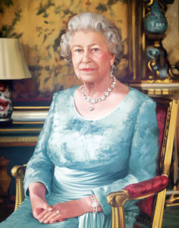
Mission Number Six:
Muddled Queen
Mission Number Five:
Brownie Bunting
To be cut up into pieces

Slide 17
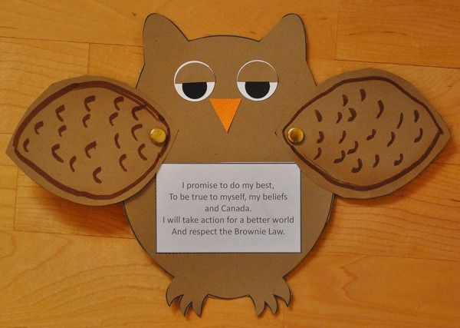
To be made for Promise Ceremonies

