Slide 1
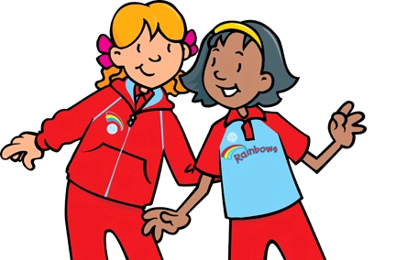
MISSION:
PRomise
Rainbow edition
By twinkle OWL

Slide 2
MISSION:
Planning
PRomise
Mission One: Promises, Promises
Discuss with the Rainbows the last Promise they made – this could be to do something or finish their homework or to return something borrowed
Colour in the Rainbow like ‘Colour by Numbers’ – you might like to sing the Rainbow Song or learn the colours in another language
Mission Two: B.E.S.T.
Ask the Rainbows to bring in either their B.E.S.T. Bear, Toy , a photo of their B.E.S.T. Person or something from their B.E.S.T. Hobby and then talk through each of their B.E.S.T.’s
Talk to the girls about what their B.E.S.T. thing to do at Rainbows is and whether they have any B.E.S.T. Ideas about what the unit could do in the future
Ask the girls to come wearing their ‘Sunday Best’ – smartest uniform, neatest hair, polished shoes etc.
If you have problems with behaviour, you could introduce a Rainbow Reward Chart – for the B.E.S.T. Rainbows to get a sticker at the end of that evening
Mission Three: I Believe You
Get the Girls to write what they believe in on their pots of gold and draw it in the cloud. This could be; fairies, Father Christmas, God or that the Gruffalo is real.
Read the girls a fairy story from the land of make believe
Put the following songs on and get the girls to dance around – you might like to play musical bumps; Smashmouth – I’m a Believer and Kylie Minogue – I Believe in You

Slide 3
MISSION:
Planning
PRomise
Mission Four: ‘Can’ you be Kind
Make the Rainbow Bead string to either attach to their Rainbow uniform or make a keyring. You will need; Ribbon or Cord String (Rainbow Coloured can be purchased cheaply on eBay), Multi-coloured Beads and possibly a safety pin or keyring.
Mission Five: Secretly Serving Others
Get each Rainbow to help people on 5 different occasions either in the holidays or between meetings – they may need to get an adult to help them write what they did to help. You could provide each girl with 5 stickers to stick on their chart for completing each secret serving.
Mission Six: Fingers & Thumbs
Rainbows have only recently begun in being able to salute and some will struggle with managing to salute. This is where the paper hand is brilliant. Print off the hand template and cut out – then get each Rainbow to fold it according to the salute.
Other Mission Ideas
Play the Secret Agent Rainbow Race Game
Create Secret Agent ID Cards
Create a Spy Mission Pack including; night vision goggles, the secret files of mission promise and their ID Cards plus a magnifying glass
Play I Spy
I Can Feel a Rainbow Poem & Inside Out Face Drama

Slide 4
Mission: Promise
Mission Number One:
Promises, Promises
Mission Number Two:
B.E.S.T.
Mission Number Three:
I Believe You
Mission Number Four:
‘Can’ you be Kind?
Mission Number Five:
Secretly Serving Others
Mission Number Six:
Fingers & Thumbs

Slide 5
Secret Agent:
.…………………………
Your mission, if you choose to accept it, is to complete a series of Challenges in order to help you understand ‘What it is to be a RAINBOW’ & the RAINBOW PROMISE!
WRITE YOUR NAME HERE!

Slide 6
The
RAINBOW Promise
I promise that I will do my best to think about my beliefs and to be kind and helpful.

Slide 7
Mission Number One:
Promises, Promises
Have you ever made a Promise Before?
It’s very easy to promise something but you must make sure you do it secret agent or your mission could go wrong!
What was the last thing you promised to do?
.…………………………
I need my top secret agents help and you must promise to complete this. It seems that the sky got a bit muddled when making its latest rainbow and it forgot to put the colour in. Can you decode the rainbow and make it colourful again?

Slide 8
S
E
I PURPLE
S ORANGE
E BLUE
I
M
P RED
R YELLOW
O PINK
M GREEN
O
R
P

Slide 9
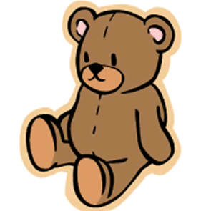
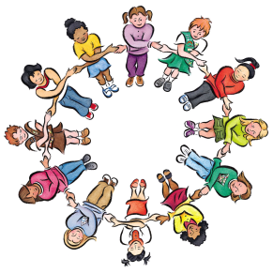
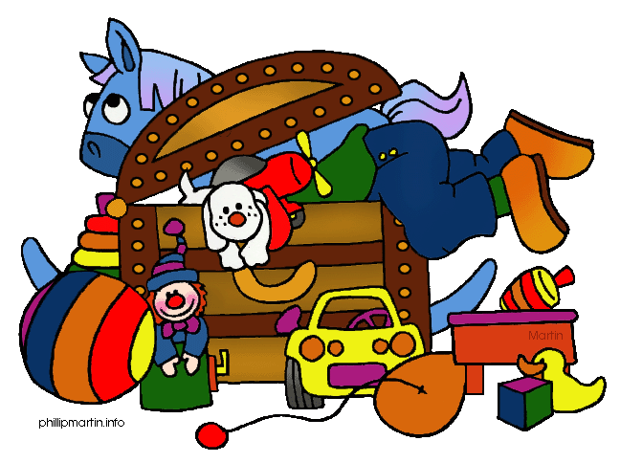
Mission Number Two:
B.E.S.T.
Mission’s B, E, S & T require you to bring ONE of your B.E.S.T. things in to RAINBOW’s, then Secret Agent, you need to complete your mission report of what is your B.E.S.T.
Mission: B | What is your B.E.S.T Bear’s name? -----------------------------
Mission: E | What is your B.E.S.T. Enjoyment? -----------------------------
Mission: S | Who is your B.E.S.T. Someone? -----------------------------
Mission: T | What is your B.E.S.T. Toy? -----------------------------

Slide 10
Mission Number Two:
B.E.S.T.
All Secret Agents are required to help make the Rainbow Leaders their B.E.S.T.
We need you to tell us what your B.E.S.T. thing you like to do at Rainbows is…
.…………………………
And we want to know your B.E.S.T. Idea of something we could do in the future at Rainbows…
.…………………………

Slide 11
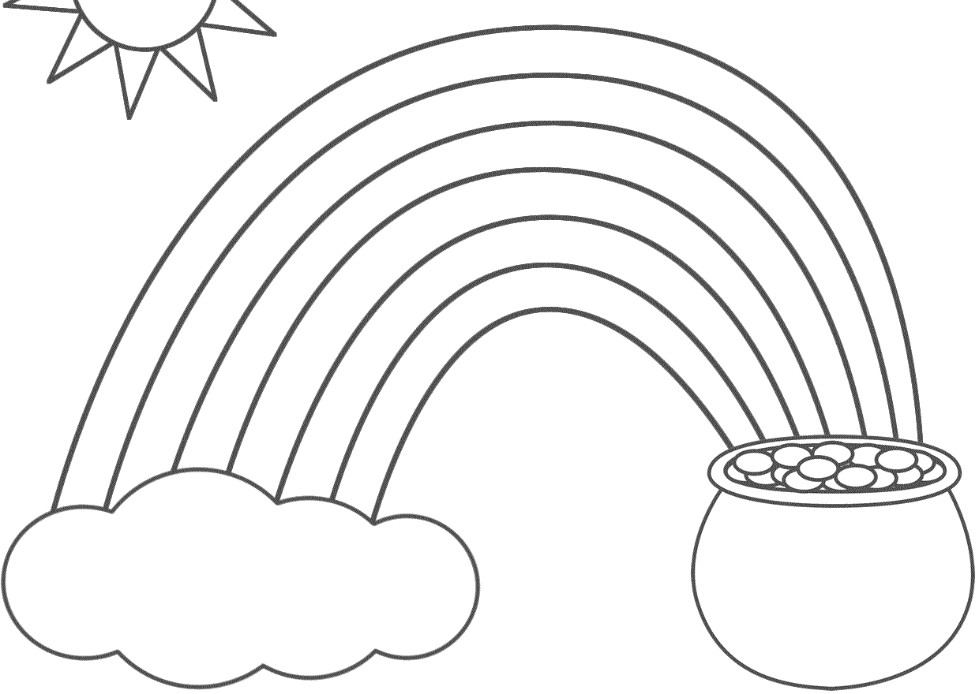
Mission Number Three:
I Believe You
Secret Agent, you must think of something that you believe. Once you have thought write it in the pot of gold and draw it in the cloud.
Then be ready to share why you believe in that with the other Agents!

Slide 12
Mission Number Four:
CAN YOU BE KIND?
Secret Agent here are your mission requirements…
Red: Brave Orange: Trusted Yellow: Helpful Green: Eco Friendly Purple: Friend Blue: Polite
Agent, we need you to promise to be kind and use this ribbon and these beads to make a symbol of your kindness to give to a fellow Rainbow – perhaps one you don’t know very well.
Thread the beads onto the ribbon in the correct order and ask a senior Agent to help you tie a knot!

Slide 13
Mission Number Five:
To Secretly Serve Others
For the Next Seven Days you are required to perform random good deeds in order to help other people.
First, you must pick your target.
This will be the person you will help.
Then, you must decide on a kind deed or act to perform for them.
GET AN ADULT TO HELP YOU BUT
DO NOT BLOW YOUR COVER!
Examples of kind deeds or acts:
Do a chore.
Give a parent a big hug to make them Smile.
Smile at 3 people.
Help bake something for someone.
Put your rubbish in the bin.
Set the table for dinner.
Remind someone of something they forgot.
Good Luck Agent on Your Mission to Secretly Serve Others!

Slide 14
Mission Number five:
To Secretly Serve Others
 | Draw Your Target (who you helped) | Your Good Deed (get a grown up to help you write if needed)
1.
2.
3.
4.
5.

Slide 15
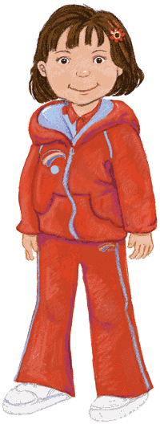
Mission Number SIX:
Fingers & Thumbs
The RAINBOW Salute
Agent, it seems Olivia’s hand cannot remember how to salute! Help Olivia by folding down the right finger and thumb on the paper hand in your Mission Pack to show the RAINBOW Salute.
This is the action which you do while saying your Promise.

Slide 16
Mission Number Six:
Fingers & Thumbs

Slide 17
Other
Missions

Slide 18
Roll the Dice to get each number.
Once you have rolled that number, put a sweet onto the number.
When you have rolled all 6 numbers you can eat the sweets!
1.
1.
1.
1.
1.
2.
2.
2.
2.
2.
3.
3.
3.
3.
3.
4.
4.
4.
4.
4.
5.
5.
5.
5.
5.
6.
6.
6.
6.
6.

Slide 19
RAINBOW SECRET AGENT
Agent Name: ……………… |  |  | Photo I.D.
Hair Colour: ………………
Eye Colour: ………………
 |  |  | Finger Print:
Special Skill: ………………
Clearance Level:
Mission 1 | Mission 2 | Mission 3 | Mission 4 | Mission 5 | Mission 6
Fill in your Name, Hair Colour, Eye Colour and Special Agent Skill.
Draw Yourself or Bring in a Photo & Stamp Your Finger Print
For Each Mission You Complete in Mission Promise you can gain a sticker to increase your security clearance until you are a 00-RAINBOW!

Slide 20
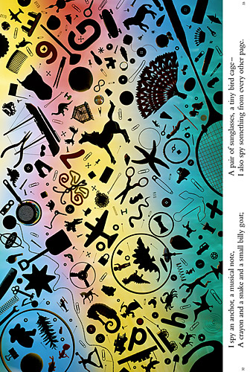
I Spy With My Little Eye,
Something Beginning With…

Slide 21
Read the ‘I Can feel a Rainbow’ Poem to your Rainbows and get them to portray the emotions included by pulling various faces at the different points of the poem.

