Slide 2
The Challenge
In order to complete the challenge, each Brownie must complete 1 activity from each of parts 1-4, 2 activities from part 5 plus a further 2 activities (although 1 of these may be the exploration).
You may choose to split the girls into teams to complete the activities thus allowing them the chance to earn points for completing or winning the challenges. Alternatively complete the challenge as a whole unit, non-competitively.
Feel free to adapt and alter any challenges in order to suit your units needs or even add some more activities in. You are welcome to visit our Pinterest board for more ideas: https://uk.pinterest.com/rebeccajaynedil/im-a-brownie-get-me-out-of-here/
If you have any questions, comments or feedback, please get in touch via email.

Slide 3
Creepy Crawly Cooking
I don’t know about your Brownies, but ours simply love to bake and cook. We therefore baked Butterfly Biscuits with our Brownies, meaning they made their own snacks for the Saturday of Pack Holiday. They also made dessert on the Sunday which was ‘Dirt Pudding’! Finally they had a lunchtime extra of ‘Creepy Crawly Crackers’!
This part of the challenge comprises:
Butterfly Biscuits
Dirt Pudding
Creepy Crawly Crackers
Monkey Cupcakes
Butterfly Pretzels
Please select at least one activity from this area to be part of your challenge.

Slide 4
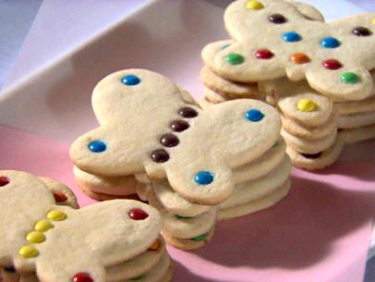
Butterfly Biscuit
Bakes
Heat oven to 180c. Mix 250g softened butter and 140g caster sugar in a large bowl with a wooden spoon, then add 1 egg yolk and 2 tsp vanilla extract and briefly beat to combine. Sift over 300g plain flour and stir until the mixture is well combined – you might need to get your hands in at the end to give everything a really good mix and press the dough together. Roll the dough out to 1-2cm thickness and use a butterfly cutter to cut the biscuits out (makes about 24 biscuits). Lay the biscuits evenly apart on a baking tray and bake for 12-15 minutes.
In order to decorate the biscuits either use icing and sweets and let the Brownies Imaginations run wild or put chocolate drops or smarties onto the biscuits before putting them into the oven.
If you want to make the biscuits more exciting then why not bake them on a stick or substitute 50g of flour for 50g of Cocoa Powder and add 180g of chocolate chunks.

Slide 5
We allowed the girls to work in their sixes and make a batch for each groups dessert.
Mix the Chocolate Angel Delight with Milk according to the packet instructions and leave for 5-10 minutes.
While the Angel Delight is setting, bash the Oreos in a zip lock bag using a rolling pin (the more they are crumbled the less the white cream will be obvious).
Finally layer the chocolate delight and the Oreos into an individual pot for each girl and add a couple of jelly snakes to the dirt.
5 packets of angel delight plus 2 packets of Oreos will feed 20 girls. We purchased 3 packs of jelly snakes for £1 in Morrison's for our ‘Worms in the Dirt’.
Dirt Pudding

Slide 6
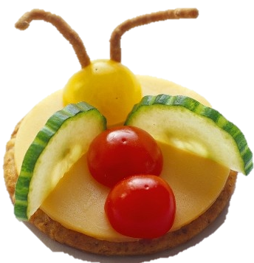
Creepy Crawly
Crackers
Layer cheese onto a cracker and decorate with cherry tomatoes, cucumber and ‘Nik Nak’ crisps.

Slide 7
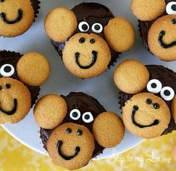
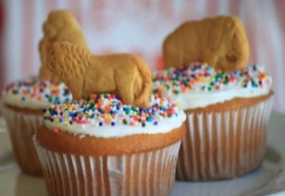
These can be made from scratch using a simple cupcake recipe or a banana cupcake recipe. Alternatively you can decorate ready made buns.
A good Cupcake Recipe can be found here: http://www.bbc.co.uk/food/recipes/cupcakes_93722
Banana Cupcake Recipe:
Preheat oven to 180c. Line a bun tin with 12 cupcake cases. In a mixing bowl, cream together 125g of butter and 125g of sugar until fluffy. Gradually beat in 2 eggs until mixture is smooth. Fold in 125g plain flour, 2tsp of baking powder and 2 small/medium mashed bananas. Divide between cases and bake for 20-25 minutes. Cool and decorate.
Decorate the buns with a simple chocolate butter cream icing or ready made icing such as ‘Betty Crocker’. Use small circular biscuits for the snout and ears and mini marshmallows for the eyes. Then decorate with a black fine icing pen to add the monkey’s features.
TIP: For Units completing this challenge pack in one night, the buns can be made and frozen one week, then defrosted and decorated another week. Or for a simple decorating option, use buttercream and add ‘Animal Biscuits’ plus sprinkles!

Slide 8
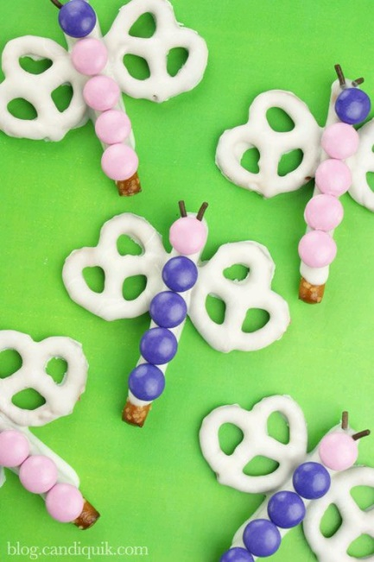
These are perfect if you are completing the challenge badge alongside fundraising or near mothers day as these can be sold or given as gifts. They are cheap and easy to make and also very tasty.
Simply Melt white chocolate and dip either part of a breadstick or a stick pretzel in and cover fully except for the tip. This will form the body and should be placed onto a strip of baking paper. Next dip a small pretzel into the chocolate and place it next to the body ensuring there is a good amount of chocolate linking the two. Repeat this process in order to finish adding both wings. Decorate with smarties, M&Ms or chocolate drops. Finally, add some sugar strands to create antennae. These can be packaged into clear bags and tied up with ribbon once they have set.
Chocolate Butterflies

Slide 9
Evening Adventures
This part of our challenge made up our evening events while on pack holiday. However they will also be a great fun evening for units completing this challenge as part of their weekly meetings.
It comprises:
Creepy Crawly Bingo
Snakes & Vines Quiz
Butterfly Ball & Grasshopper Feast
‘Saving Sam’ the Snake
Beetle Drive
Please select at least one activity from this area to be part of your challenge.

Slide 10
Creepy Crawly Bingo
Please find the bingo cards, cover cards and calling bugs attached.
Whenever you pull out a bug that the Brownies may have, they must cross out the bug.
We gave out jungle themed prizes for a line or a full house.
TIP: In order to preserve the game, print off the ‘cover cards’ as well and laminate everything. For each Bug a Brownie has, they can cover it over with a ‘cover card’.

Slide 11
Snakes & Vines Quiz
Please find the quiz questions, answer cards and Snakes and Vines boards attached.
You will also need to have one dice for each six.
Each six must attempt to answer the quiz.
Once all the questions have been answered you must provide the answer for each question.
For every right answer, each six may roll the dice and write down the number they rolled. The six must then move their counter across the board according to the numbers they rolled, treating the vines as ‘ladders’ to climb up and snakes to fall down.
At the end of the answers if no one has reached the top then the six highest up the board will win!

Slide 12
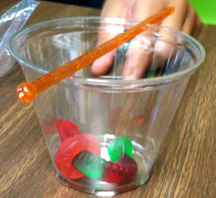
‘Saving Sam’ the Snake
This is a brilliant team building challenge that will engage and frustrate the Brownies until they find a solution.
Each six will need:
Gummy Snake (Sam)
Gummy Rings (Life vests)
Clear plastic cup (Boat)
Lolly Pop Stick (Oar)
2 Paper clips
Poor Sam is a Snake who was sailing down a jungle river. After encountering the deadly rapids, his boat capsized. Sam cannot swim and his life vest is trapped under his boat. He now sits on top of his boat with his oar, contemplating what to do next. You must SAVE SAM by flipping the boat back over, sitting Sam in it and popping on his Life Vest. However, you cannot touch Sam. You may use the paperclips as well as the ‘oar’ provided but you cannot stab him or let him fall into the water.

Slide 13
There are far too many bugs in the Jungle but this allows the Brownies to create a few more!
I’ve attached the beetle drive sheet for drawing version of the Beetle Drive.
DRAWING Version: For this you will need:
Beetle Drive Sheets, Pencils and 1 Dice per Six.
Allow the girls to pass the dice around the six attempting to roll each number in turn so that they can draw their bug. They must roll a Number 1 first but after that the numbers can be in any order.
1= Body, 2= Head, 3=Antennae, 4=Legs, 5=Feet, 6= Spots
Alternatively you can complete this challenge as a 3D beetle Drive which also creates a great nightlight for camp!
3D Version: For this you will need:
Plastic Eggs (with holes poked in prior to session), Googly Eyes, Pipe Cleaners and Glow Stick or Small Electric Tea Lights and 1 Dice per Six.
All the girls then need to do is poke the antennae and legs into the body and stick on the eyes and wings whenever they roll the appropriate number.
1= Body, 2=Left Legs, 3= Wings, 4= Eyes, 5= Antennae, 6=Right Legs
Beetle Drive

Slide 14
Bushtucker Trial
These activities will have your Brownies grimacing in disgust or rubbing their tummies and licking their lips.
You might be surprised that some Brownies actually love the strangest of things.
This part of the challenge comprises:
Traditional Eating Trial
Open Wide
Nuzzle In
Mystery Boxes
Please select at least one activity from this area to be part of your challenge or use them all in a combination.

Slide 15
Traditional Bushtucker Trial
Get the girls to organise themselves into lines in their sixes.
Line up a table for each six featuring 6 delicious delicacies labelled up with a number from 1-6 and a dice. Each girl at the front must roll the dice and eat the delicacy which corresponds to that number.
Should the girl refuse they must suffer a forfeit. (Please find our list of suggested forfeits attached).
The girls should all have a go in turn and you can repeat the rounds as many times as you like but each girl must not eat the same delicacy twice (Please find our tick list for completed delicacies attached).
We used the following delicacies:
Frog Spawn (Tapioca or Rice Pudding)
Pickled Slugs (Gherkins)
Kangaroo Eye Balls (Lychee)
Monkey Snot (Mushy Peas)
Minging Maggots (Cold Baked Beans)
Bugs (Gummy Bugs)

Slide 16
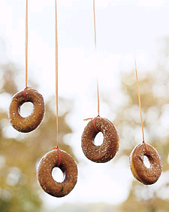
Open Wide
Your Brownies have become ‘alligators’ and they must lay in the swamp (on the floor) awaiting their prey.
All the girls must lay on the floor in a row. Then you may lower a cane threaded with string and donuts and prop it up over the girls heads. The girls must then keep their bodies flat on the floor only lifting their heads. They must try to eat the donut from the string within a minute – ‘A Minute to Win It’!
TIP: Use mini donuts from the bakery section of a supermarket to make it easier and cheaper.

Slide 17
Nuzzle In
You can use this as a forfeit or for the winners of games to earn more points. Alternatively set it up for everyone to have a go and get mucky – perhaps when they roll a 6 on a dice like the blindfolded chocolate cutting game
You will need:
3D stars
(make them out of salt dough or buy star shaped balloon weights)
Flour
Bowl
Tray
Blindfold
Put some flour in the bowl and then put the star in, add more flour into the bowl until its full. Flip the bowl onto the tray and remove the bowl carefully so the flour sits on the tray in the bowl shape. When it is the Brownies turn, they must then be blindfolded and clasp their hands behind their back. They must then lower their heads to the flour and nuzzle about in the flour to get the star and lift it out of the flour in their teeth. To make it harder – you could use smaller stars or add in plastic spiders.

Slide 18
Mystery Boxes
This is a good game to have as part of a round of different activities for the Brownies to move round in their sixes.
You Will Need:
Boxes
(Shoeboxes are perfect & they need a hole cutting in the side)
Plastic Creatures and Insects
Furry Fabric
Cotton Wool Balls
Golden Syrup/Treacle
3D Star
(or something equivalent for them to find in Box5)
Each box will need a mystery surprise, we set up 5 for each six to have a go at.
Box 1: Plastic Creepy Crawly, Box 2: Plastic Jungle Animal, Box 3: Fur, Box 4: Golden Syrup, Box 5: Cotton Wool Balls & 3D star hidden
In the first 3 boxes they must guess what they are feeling and then the 4th box makes it difficult to find the hidden object in box 5 as the cotton wool balls stick to their hands.
You could have it that Brownies earn points for every box they guess correctly and they may only do box 4 & 5 if they get box 1,2 & 3 correct.

Slide 19
Crafty Crafts
These activities will create a lasting item for each Brownie to take home and remind them of the fun that they enjoyed during this challenge. We particularly liked the Butterfly Photo Peg as we kept hold of them after our pack holiday and printed off a photo of the weekend for each girl to have on their pegs.
This part of the challenge comprises:
Spinning Spiders
Paper Plate Wind Spinners
Butterfly Photo Peg
Telling the Time with Sunshine
Please select at least Two activities from this area to be part of your challenge or use them all in a combination.

Slide 20
Spinning Spiders
Each Brownie Will Require:
A Fork, Black Wool, Googly Eyes & Pipe cleaners
To Make, loop the wool around the fork until it looks like you’ve wrapped the fork full of spaghetti and you're ready to try and cram it into your mouth. Then tie a piece of wool around the middle of the wool in between the middle prongs of the fork. Once secure, cut either side of the pieces of wool before trimming the pompom for neatness.
(This website shows you clearly and with images how to do this: http://www.taradennis.com/Kids/pom-pom-garland.html)
Now you have your pompom and you can thread some pipe cleaners carefully through the middle for legs and stick on some googly eyes.
Additionally you could provide each Brownie with a paper plate which has its middle cut out. Give them a hole puncher to punch holes round the edge and let them thread wool through the holes to create a Spiders Web!

Slide 21
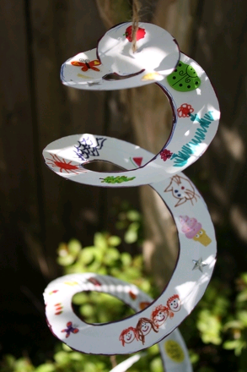
Paper Plate Wind Spinners
You can either pre-draw a spiral onto a paper plate or allow each Brownie to do it herself. The spiral must then be cut and decorated. Then make a hole in the centre and attach some string in order to hang it up.

Slide 22
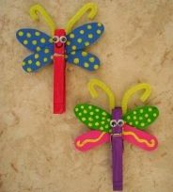
Butterfly Photo Peg
You will need: Wooden Clip Pegs, Foam or Card, Googly Eyes and Pipe Cleaners.
Decorate the body with mini-pompoms or sequins or glitter or felt tips then add googly eyes at the top and pipe cleaners for antennae.
Cut out wing shapes from either card or foam and stick these on top of the peg once decorated.
You could also provide magnetic spots so that these can be hung on the Brownies fridges at home.

Slide 23
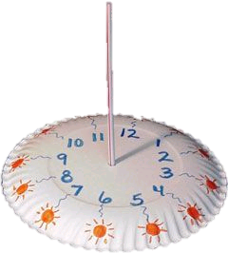
Telling the Time with Sunshine
One of the worst things a Brownie can nag you for is the time. You hope that you are providing exciting and enjoying activities and that will stop them from contemplating the time. Although on Pack Holiday nagging for the time usually means they are wondering when they will be eating next!
This method of telling the time will intrigue the Brownies and should you have a nice fine day it will be perfect for them to keep checking.
You can let the Brownies complete this independently or in pairs.
You will need:
Paper Plates, Straws, Sellotape and Felt Tips (or other decorating materials)
Draw 12 marks onto the paper plate – these will signify the 12 numbers on a clock and decorate around these.
Next, punch a hole in the middle of the plate and insert a straw – sellotape this in place with the bendy bit coming through the hole.
Find a sunny spot and place the dial on the ground and watch where the shadow of the straw falls.

Slide 24
Big Brownie Challenges
These activities will get the Brownies working collectively together, boggle their minds in some cases and encourage them to get active while having fun.
This part of the challenge comprises:
These challenges may be completed on an activity day, or on camp/pack holiday or even in a normal session providing you have space/outdoor access. You may choose to let the Brownies complete these in their sixes/groups allowing them to earn points, or simply use them as games.
Please select at least Two activities from this area to be part of your challenge or use them all in a combination.
Dingo Dollars Water Challenge Scavenger Hunt Jungle Art Afforestation/Deforestation Bash a Bug Balloon Ping Pong Balloon Volleyball Frog Tag | Snake Egg Hunt Frozen T Shirt Challenge Elephant Bulldozing Plane Crash Cup on a String Human Newspaper Snake Life on a Leaf

Slide 25
Dingo Dollars Water Challenge
Each Six Will Need:
Tube with holes in (perhaps drain pipe)
Plastic Bottles with Holes in the bottom or tubing cut in half
3D star (salt dough or balloon weight)
Large container of water
The Brownies are split into their sixes and are required to transport water from a water container into a tube in order to raise the star up from the bottom so that they can reach it at the top. This is a race to see who can fill it up the quickest while keeping the most water.
You may choose to let them do this either one of two ways. They may use plastic bottles with holes in to transport the water and complete it in a relay. Or you may provide tubing cut in half requiring the Brownies to stand in a row holding this and tipping the water down the tube and keep gradually moving along to reach the final tube.

Slide 26
Scavenger Hunt
Method 1: | Method 2:
Split the Brownies into their Sixes or into groups and provide them with a digital camera. Then allow them a certain length of time to take photos of ‘Jungle’ items from this list: Something Rough, Something Soft, A Bug, Something Prickly, Something Green, A Rock, Something Blue, Something White, Flower, Something Brown, A Square, A sign, Something Wood, A Circle, Something Shiny, An Interesting Cloud and Something Huge. This is a lovely activity for the Brownies to complete as it provides a set of pictures that may be printed off and stuck into camp diaries. | We completed this activity by giving each six a paper bag (we used small Primark bags) with images of different things we wanted them to collect stuck on the side. This included: Leaf, Flower, Stone, Something Edible, Stick, Seed, Something Smooth, Something Rough, Something Spiky, Something manmade and Something Interesting. The Brownies were given half an hour to walk around the pack holiday camp site in order to find these items. Once they had found an item it could be collected in their bags. When each six had filled their bags and ticked off each item they were able to use these items to create their Jungle Art which is the next activity.

Slide 27
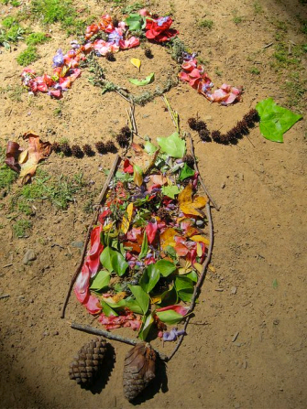
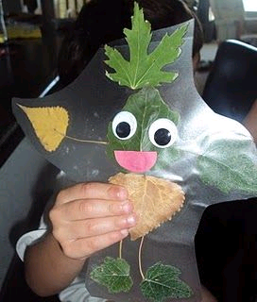
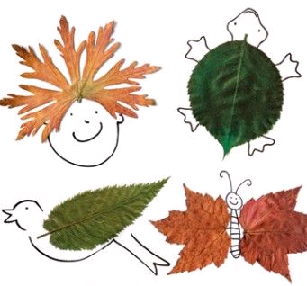
Jungle Art
Method 1: | Method 2:
You can use any items collected on the scavenger hunt if you used ‘Method 2’. Alternatively you may factor in 10-15 minutes for them to run off and find component parts. You must set the Brownies a challenge of creating a picture using things from nature, they may choose to create a landscape or a person. This will be done as a six. | This may be done individually or in pairs. You give each Brownie/Pair a laminating pocket and ask them to create a person using only things from nature inside the pocket. This may then be laminated and each Brownie may take their creation home (perhaps stuck into their pack holiday diary). You may choose to give them paper eyes or a big pair of lips to add to their person.
Alternatively, You may just ask them to find leaves and get them to draw additions to the leaves to make them into something.

Slide 28
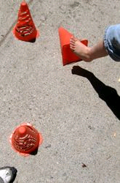
Afforestation/Deforestation
This highlights to the Brownies the problems with globalisation and the growing population. It shows that once a tree has been cut down there is a great need to plant a new one. You could talk to your Brownies about why the world needs trees and what trees provide.
You will need a set of 24 cones. Divide the Brownies into 2 teams. One team must attempt to knock all of the cones over (Deforestation). While the other team must keep standing the cones back up(Afforestation). If the Deforestation team manage to knock over all of the cones at one single time, then they win. Or give them 2 minutes and see how many are knocked down versus stood up to see who won.
It’s a good idea to swap over and let each team have a go at being both afforestation and deforestation.

Slide 29
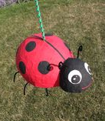
Bash a Bug!
We managed to purchase a butterfly shaped piñata (from Argos). We gave each girl the chance to have a go at whacking the bug to break the butterfly open, gaining access to the sweets inside.
Alternatively you could make your own piñata using Papier Mache and a balloon.

Slide 30
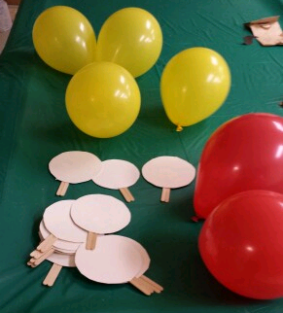
Balloon Ping Pong &
Balloon Volley Ball
Split the Brownies into Pairs. Set a piece of string across the middle of the room with one half of each pair on each side. Give each Brownie a Ping Pong Paddle and let them play ping pong. Alternatively allow them to play in teams. The Paddles can be made using circles of card or paper plates stuck onto lollypop sticks. | Split the Brownies into teams. Thread up string across the middle of the room or outside space (if it’s a calm day). The Brownies are only allowed to kick the balloon into the air and over the ‘net’ and must not remove their hands from the ground

Slide 31
Frog Tag
All the Brownies must bounce and jump around like frogs in a crouching position. Appoint a couple of Brownies to be Poison Frogs. They must bounce round poisoning more frogs. When a Brownie gets poisoned they must freeze on the ground and may only move again when they have been leap frogged by another non-poisoned frog.

Slide 32
Snake Egg Hunt
This is perfect if you have chosen to complete our challenge at Easter Time.
We used little plastic eggs that can be purchased around Easter time, however you can also use printouts of eggs.
We hid these around the camp area on pack holiday and allowed the girls half an hour to find as many eggs as they could in their sixes.

Slide 33
Frozen T-Shirt
Put a t-shirt in a zip lock bag alongside a small amount of water. (We collected free t-shirts from a local company giving them away but you could also use old t-shirts belonging to the Brownies or their parents if you ask in advance.)
Freeze the t-shirt in the bag. Give each six a frozen shirt and give them 10 minutes to get the shirt on one of the Brownies in the six. They may try licking it, blowing on it, hugging it or jumping on it in efforts to defrost it.

Slide 34
Elephant Bulldozing
This is completed as a relay race in sixes.
Give each six a pair of tights with a tennis ball in the end of one leg.
Each Brownie must then in turn put the tights on their head and swing their head from side to side to move their ‘trunk’. The trunk must then be used to knock over tin cans or cones. Once each Brownie has knocked them all over, they must retrace their steps rebuilding the course to give the trunk to the next Brownie so they all have a go.

Slide 35
Cup on a String
When you see the words ‘cups’ and ‘string’ together, you think of making telephones as a child to communicate with someone in the next room.
But this game requires team work and problem solving.
Split the Brownies into teams of 4. Each team is given a rubber band, 4 pieces of string and 4 cups.
They must then use the string and rubber band to pick up each cup in turn and stack it on top of one another.
To do this, they must tie the string onto the band, and each hold onto a length to pull the band wider and around the cup. They must then let the band spring tight and lift it up and onto one main cup, before repeating the process.
You can choose whether to give them a time limit and grant points or prizes to the teams which have the most or all cups stacked. Alternatively grant points or prizes for the first, second or third to complete.

Slide 36
Life on a Leaf
This game is like Musical Chairs. You begin with each Brownie having a leaf (leaf shape cut out of newspaper). Play some music and get them moving around. When the music stops they must stand on any leaf. Each time you play the music again then remove a leaf, until there is one leaf and 2 brownies left.

Slide 37
EXPLORATION
When completing the challenge you may choose to go on an exploration. We embarked on an adventure with some exploring, encountering nature and conducting experiments.
We walked from Whiteley Woods (our pack holiday site) to forge dam. This provided us with the opportunity to get off site, stretch the girls legs and see the local area.
During the adventure, we asked the girls to collect any items of nature as required to create art with nature.
We also provided a Pond Dipping Activity in the shallows at forge dam which allowed the girls the opportunity to encounter lots of real life creepy crawlies.
Finally we ended the exploration with an ice cream.

Slide 38
Pond Dipping

